Slide 1
Marketing in 2014 and beyond: It’s All About Content
Presented By
Danny Rubin, Vice President
Rubin Communications Group
@RubinComm
Notes:
Content Marketing

Slide 2
The big shift
Hello,
value-based SEO
@RubinComm

Slide 3
RCG’s content plan
@RubinComm

Slide 4
“Consistency is King”
@RubinComm

Slide 5
Here’s the key
Be valuable by being helpful
@RubinComm

Slide 6
Helpful content
@RubinComm

Slide 7
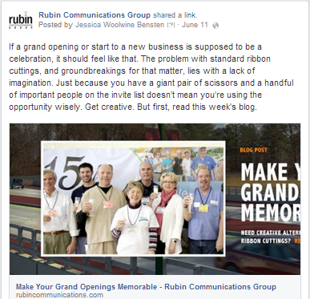
Content on social media
@RubinComm

Slide 8
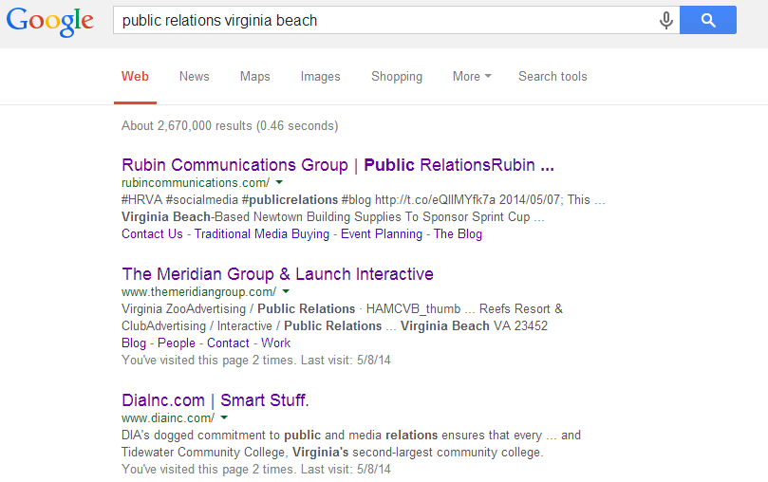
The end result
@RubinComm

Slide 9
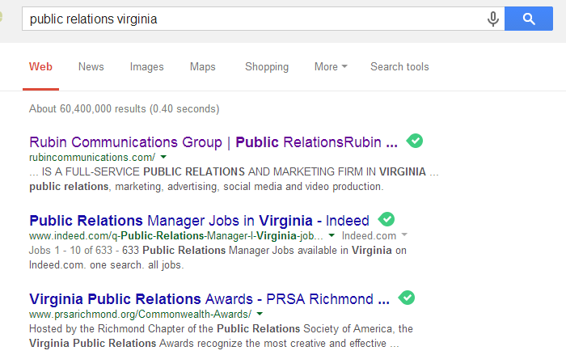
Across the state
@RubinComm

Slide 10
Only halfway there
Strong search rankings matter, but what about your core audience?
@RubinComm

Slide 11
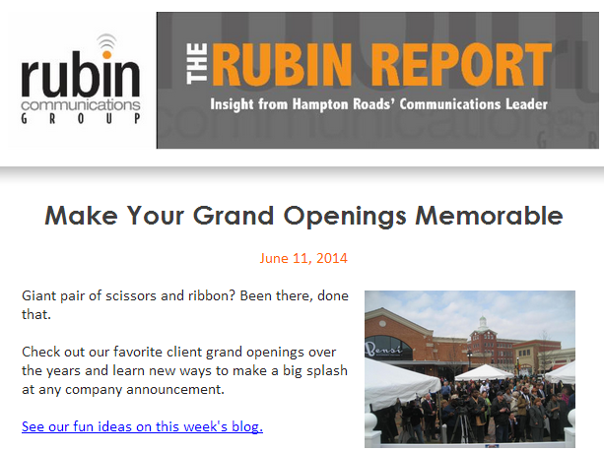
Power of e-marketing
@RubinComm

Slide 12
Double trouble
Rich content improves search ranking AND builds brand awareness.
@RubinComm

Slide 13
More than blogging
Webinars on tricky topics (ex: how-tos)
Downloadable white paper or e-book
Live Twitter chat
Helpful YouTube videos (also improves search ranking)
Blog posts as guest columns in traditional/digital outlets
Develop a platform, a voice – BECOME the expert
@RubinComm

Slide 14
The reality
Everyday,
you plant seeds.
@RubinComm

Slide 15
In five years…
Every company will do this.
@RubinComm

Slide 16
Why wait?
Start now and be five years ahead.
@RubinComm

Slide 17
The Southwest story
@RubinComm

Slide 18
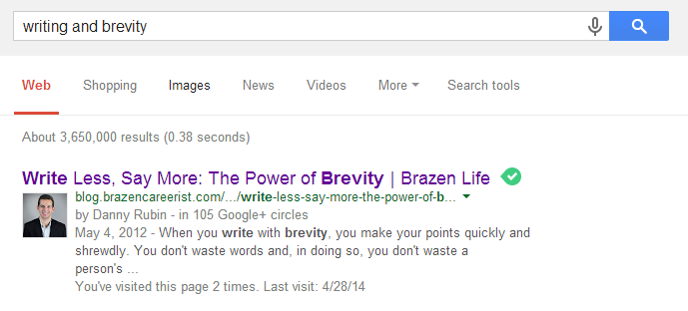
Content is powerful
@RubinComm

Slide 19
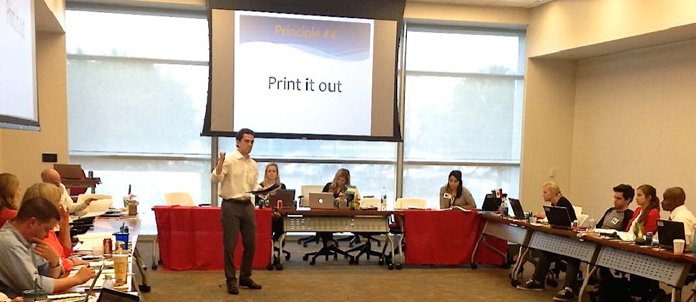
Content is powerful
@RubinComm

Slide 20
Start your content plan!
Download our presentation:
rubincommunications.com/cbda
@RubinComm

